Slide 1

Three Months Report

Slide 2
Week 1 – Week 3
Deep Learning
CNN
Generative Adversarial Network
GAN Metrics
Transfer Learning
Built an image converter that converts tif to jpeg format without saving the images.

Slide 3
Week 4 – Week 5
SEM-AI Frontier ToolKit
FID and Inception Score Implementation
Optimizations and Improvements –
Upgraded and replaced deprecated dependencies
TF 1.x to TF 2.x
Disadvantages of Official Implementation –
Everything couldn’t be ported to TF 2.x
InceptionV3 2015

Slide 4
Week 6 – Week 7
A new Keras Implementation with
Latest dependencies.
Batch Wise Implementation
Error Handling
Evaluation of StarGAN with implemented GAN Metrics
GAN Augmentation Testing

Slide 5
Week 8 – Week 9
Training StarGAN and StyleGAN with CelebA and HQ Dataset.
Also checked various open source GAN Models with HQ Dataset - StarGAN, CycleGAN, StyleGAN ALAE.
CycleGAN gave promising results.
Differential Augmentation on dataset
Hyperparameter tuning with different epochs and batch size.

Slide 6
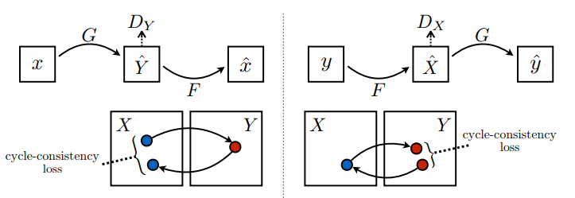
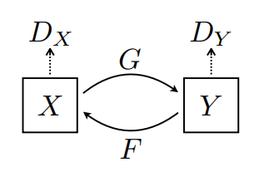
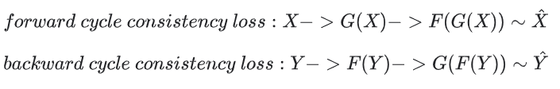

CycleGAN

Slide 7
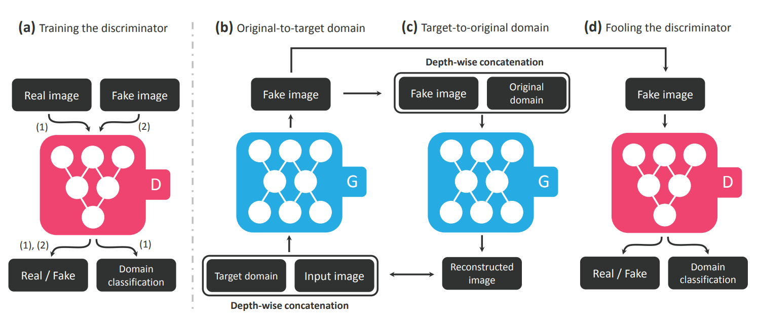
StarGAN

Slide 8
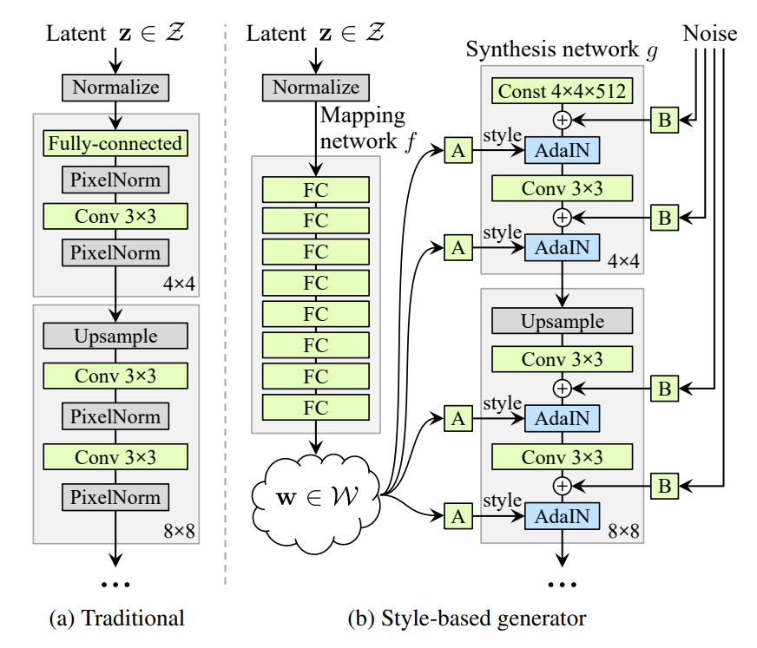
StyleGAN

Slide 9
Week 10 – Week 12
Code walk through of Scripts folder –
DLProcessWrapper.py, GAN.py, GAN_Model.py, GAN_Train.py, GAN_Loss.py
Learning by putting breakpoints.
Changing code snippets bit by bit and testing.
Problems –
Override layers __init__ with ‘get_config’
Parsing json model during loading the model, custom object (InstanceNormalization) to be added.
Images are generated with color distortions when integrated with SEMAI Tool.
After 1.5 weeks – CycleGAN Integration Completed!

Slide 10
Week 12 – Week 13
Training models to get good dust images with integrated CycleGAN.
Training with pretrained weights from open source CycleGAN Model previously trained with.
Minor bug fixes and improvements.

Slide 11
Summary
GAN Metrics Implementation – FID and Inception Score
CycleGAN Integration
StarGAN generated image color correction.
Various GAN Models Testing and Benchmarking the results for clean and dust dataset.

Slide 12

Thank You

